Slide 1
Contra Costa County Community Network Listening Sessions Report
Prepared by: Health Leads | June 24, 2021

Slide 2
Background
Contra Costa County organization and resident leaders, known as CIE Co-Creators, held a series of focus groups/listening sessions in May 2021 involving a variety of people representing diverse populations in Contra Costa County, including Latinx mothers, young men of color under the age of 24, members of the BIPOC LGBTQ+ /faith community, and a collaborative group of BIPOC East and West county residents.
Through these listening sessions, Co-Creators gathered information to a) determine if a county-wide network to coordinate and streamline care was something the community seeks to advance racial health equity and b) unearth the bright spots and opportunities in the current service delivery landscape to inform both service delivery and network design.

Slide 3
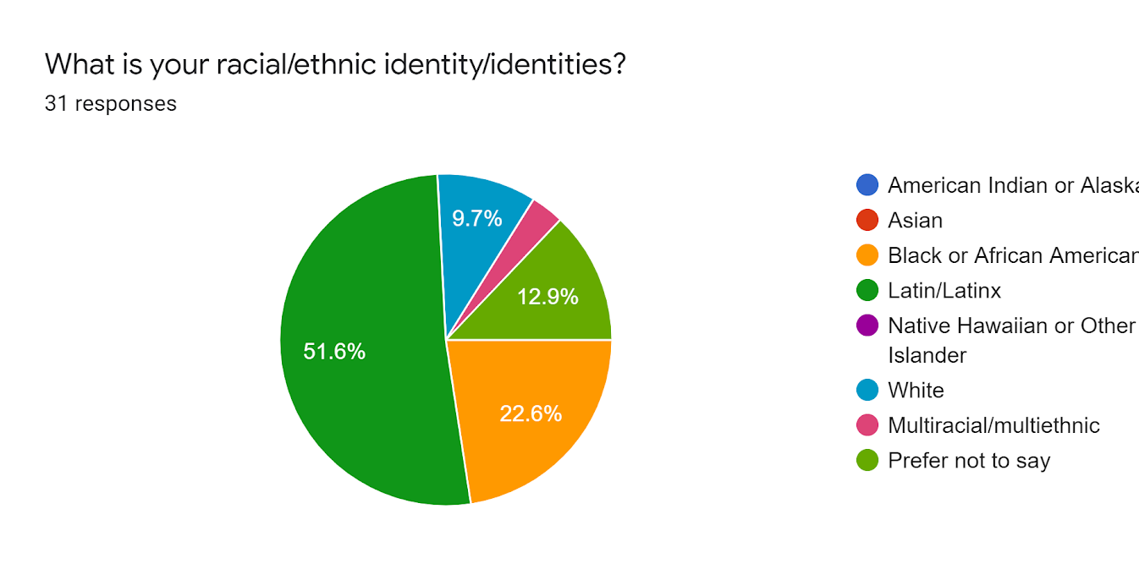
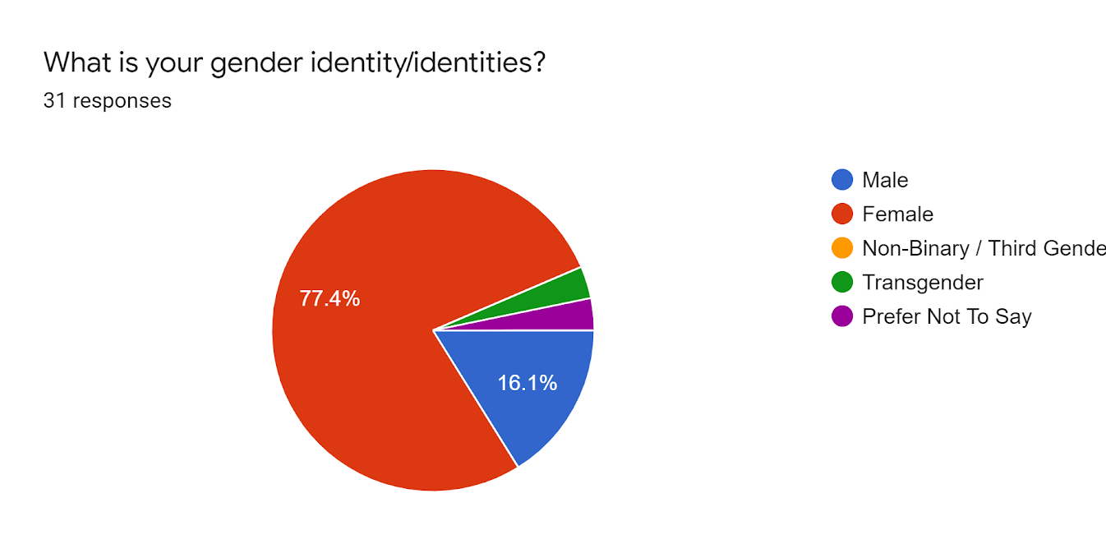
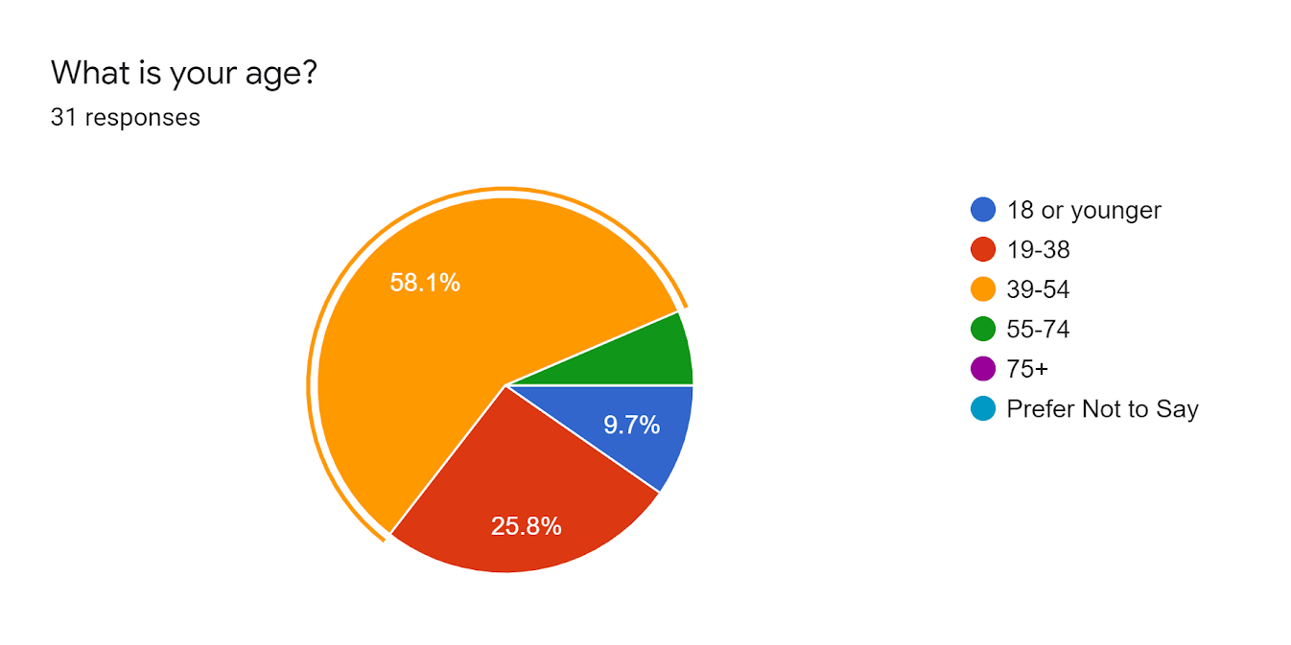
Participant Demographics
Chart 1: Race + Ethnicity
Chart 2: Gender Identity
Chart 3: Age

Slide 4
Share an experience where you felt welcomed receiving services (mental health, physical health, housing, etc). Comparta una experiencia en la que se sintió bienvenido(a) al recibir servicios (salud mental, salud física, vivienda, etc.) How do you know you have an invitation to stay? (what are the indicators)¿Cómo sabe que tiene una invitación para quedarse? (cuales son los indicadores) Share an experience where you did not feel welcomed receiving services (mental health, physical health, housing, etc). Comparta una experiencia en la que no se sintió bienvenido(a) al recibir servicios (salud mental, salud física, vivienda, etc.). What would it look like, feel like to feel welcomed into organizations when you access services? (what does the setting look like, what are people saying to you) ¿Cómo sería sentirse bienvenido en las organizaciones cuando acceda a los servicios? (cómo es el escenario, qué te dice la gente) How many times do you have to tell your story to receive the services you need? ¿Cuántas veces tienes que contar tu historia para recibir los servicios que usted necesita? Would you appreciate it if organizations have the ability to share information about you?¿Le parecería bien si las organizaciones pudieran compartir información sobre usted? How should organizations communicate with one another about your story? ¿Cómo deberían las organizaciones comunicarse entre sí sobre su historia?
Facilitation Guides for Focus Groups

Slide 5
How do you know you and your family are better off receiving these services? ¿Cómo sabe que usted y su familia están mejor recibiendo estos servicios? Defining better - peace of mind, economically better, mentally better, emotionally better, are you and your family thriving? Definiendo mejor: tranquilidad, mejor económicamente, mejor mentalmente, mejor emocionalmente, ¿está usted y su familia prosperando? How do organizations embrace the multiple identities you bring (cultural, religious practices, refugee, sexual orientation, etc…)? ¿Cómo adoptan las organizaciones las múltiples identidades que usted trae (culturales, prácticas religiosas, refugiados, orientación sexual, etc.)? (i.e., intrusive questions, fear of loss of autonomy in your family, a difference in faith-based vs. more clinical approach) (es decir, preguntas intrusivas, miedo a perder la autonomía en su familia, una diferencia entre el enfoque basado en la fe y un enfoque más clínico) Is there anything that prevents you from going to an organization for services? If so, can you share these experiences? ¿Hay algo que le impida acudir a una organización para obtener servicios? Si es así, ¿puedes compartir estas experiencias? What changes would you like to see them make to improve your experiences? ¿Qué cambios le gustaría que hicieran para mejorar su experiencias?
Facilitation Guides for Focus Groups contd.

Slide 6
Listening session findings

Slide 7
Latinx Mothers Facilitators Petronila Fernandes, Resident Leader Isabel Lara, Resident Leader
Findings:
Some reported having some positive experiences with service providers. They reported being treated well and feeling welcomed.
Some reported being treated well initially, and when their need was stated, they were no longer treated well.
Documentation and health insurance were barriers to services that were already limited. They reported not enough services to benefit everyone, and lack of insurance makes it even harder to receive services.
Many reported being mistreated due to language barriers. They also said being underestimated and dismissed if not speaking English.
Service providers may be ill-equipped to help people with disabilities with the addition of the language barrier.
Many reported the lack of cultural representation in the services they receive.
Some thought it would be helpful if organizations shared their information because they want to know what services they qualify for before repeatedly retelling their story. Also, they only want organizations to have their information if they really are going to help the community. Organizations must ask for their consent before sharing information.
Some community members have seen the benefit of receiving the services due to their own advocacy; however, they fear that many Latino families do not have the same access to the services.
Many shared a lack of trust in the system. They did not want their information shared. They were uncertain that organizations and staff had their best interest at heart.
Some feared organizations would use their information to retaliate against them.
“[Community members shared that] they are tired [of] participating in a lot of community meetings … they are invited, but we don’t see the changes” – Petronila Fernandes
“We are welcome with open arms [to CBOs], but as soon as we don’t agree with what they want us to do, the behavior is totally changed and so when they seem to start seeing pushback and they’re not served.” – Isabel Lara

Slide 8
Young Men of Color Facilitator: Kanwarpal Dhaliwal, RYSE Center
Findings:
Some mentioned feeling welcomed at RYSE. RYSE provides the access and support they don’t receive in other organizations.
Many reported not being seen, valued, or listened to by service providers. Often when they make their needs known, they are pressured to make other choices.
Some want organizations to be connected but be discreet and careful with their personal information. They find it helpful to know ahead of time if they would qualify for other services before making contact.
“These young men and boys talked about how when they walk in the door is anyone even going to look at them, is anyone going to acknowledge them, are they going … to be seen as automatically at a level of threat.” – Kanwarpal Dhaliwal.

Slide 9
BIPOC LGBTQ+/Faith community Facilitators Kiku Johnson, Rainbow Community Center of Contra Costa County Janell Coleman, Resident Leader
Findings
Some programs are trying to make changes and be more inclusive. They have changed policies and procedures.
Many reported repeated traumatic and demoralizing experiences of discrimination regarding race, gender identity, sexual orientation.
Many reported fearing for their life or the life of a loved one regarding interacting with the police. And some refused to call the police even if the situation warranted.
Many report a lack of trust in the system. They experienced many transgressions at the hand of providers.
Many worry about sharing their information and the lack of trust that their information would remain confidential.
When asked if they knew if they were better off, their responses varied. Some felt that if their basic needs were addressed and didn’t have to worry, they were better off; others said they did not know if they were better off.
“Sadly, the experiences didn't surprise me…what resoundingly came through is that folks voices needed to be heard and how little or not at all they're being engaged or asked about what their experiences.” – Kiku Johnson.

Slide 10
East/West County BIPOC residents Facilitators Roxanne Carrillo Garza, Healthy Richmond Solomon Belette, East Contra Costa Community Alliance
Findings:
Some reported very positive experiences with mental health service providers. They felt welcomed and helped.
Many reported having to tell their story to receive services repeatedly, and that repetition should not create a barrier for getting assistance.
Some report that information is hard to access in the black community. It takes a tragic situation or violence to occur for services such as crisis response mental health.
Some report feeling the benefits of receiving services, but you have to navigate many challenges to receive that service.
Many reported that their identities were reasons why they experienced various forms of discrimination. For example, immigrants with limited English speaking skills experienced both subtle and overt forms of discrimination when seeking services. One Black participant stated that she only had a good experience with health care related to pregnancy. Otherwise, stereotypes impacted her experience of accessing services. Racial identity and sheer economic status often position applicants for services in less than "equal" to those who determine the status of their requests.
Several reported that it was appropriate to have information about them shared by multiple organizations as long as they have a good reputation and a track record for serving the community on a long-term basis. However, a few were adamant about their information not be shared with other organizations whose reputations were in question.
Some reported that they would also like to see more resources invested in social services than in policing or correctional programs.
“Our ecosystem of CBOS … perpetuate [white supremacy]. And so it's … our work, like it's not about what's the platform to communicate, it's .. what really is the reckoning, we have to do [as service providers]” - Kanwarpal Dhaliwal

Slide 11
Organizations must welcome each person from the moment they engage with the services. They want their children and others present to be acknowledged. They want to enter less industrial-looking spaces and institutional-looking spaces and welcome them with art and color. The community wants people who look like them and speak their native language to serve them. They want service providers to get to know them and treat them with dignity, respect, and value and see them as important and equal. They want services that are based on their needs and circumstances. They don’t want to have to defend themselves and their need for assistance. The community wants agencies and institutions to be transparent and accountable. They want the monitoring of service delivery and the oversight of the spending of funds. The community wants to see what progress the agencies make towards their stated goals and their impact on community issues. The community wants to see BIPOC in leadership and decision-making roles at agencies and institutions, not just on the front lines. The community wants agencies to work with community leaders to rebuild and regain the trust that has been lost. They want service providers who are kind, compassionate, and empathetic. They want them to have constant and regular training so they are addressing their prejudices and biases. They want supervisors who will monitor the actions and behaviors of their staff and assure community safety and support. The community would like to have some compensation for volunteer work. It was explained that many volunteers spend their own limited resources to volunteer for established organizations. The community wants organizations and institutions to work together to integrate and streamline services so that one has access to them routinely, not just during times of crisis or trauma.
Recommendations

Slide 12
What resonated with you?
What would you add?
Should we share this information, if so with whom?

Slide 13
Thank you

